Slide 1


Credit Card Transaction Fraud
Introduction
Dr. Muzammil Behzad – Big Data Analytics Course
Abdulrahman Saleh AlRajhi & Partners Co. Ltd.
Made by: Faisal Alassaf
And Abdulaziz Aljohany
internship spanned from June 23 to August 15, 2024

Slide 2

Data Set Overview
Made by: Faisal Alassaf
Software engineer
The dataset contains credit card transactions sourced from a financial transactions database. It is used for analyzing and detecting fraudulent transactions
AlRajhi Internship
ICS/SWE-399: Summer Training – (233)

Slide 3
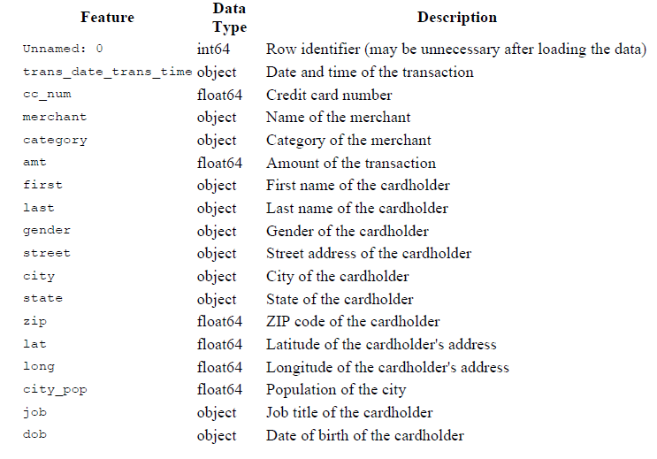
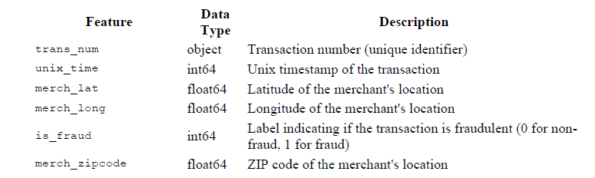
Feature Description

Slide 4
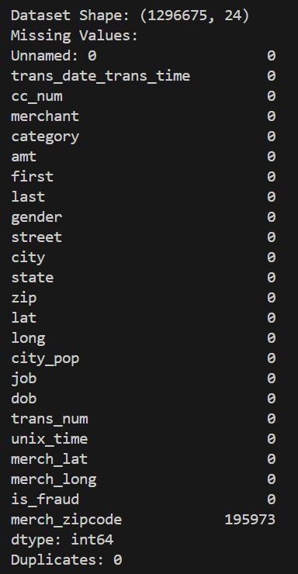
Structure and Missing Values and Duplicates
Data set contains roughly 1.3 million rows, 24 columns.
Missing Values: We identified missing values (~196k) in the merch_zipcode column.
Total missing values per column are provided in the statistical summary.
Duplicates: The dataset contains 0 duplicate rows.

Slide 5
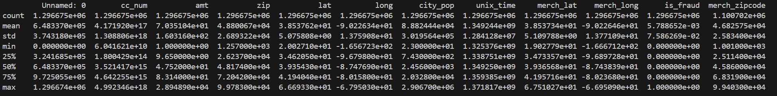
Statistical Summary
Mean, standard deviation, minimum, maximum, and quartile values for each numerical feature.

Slide 6
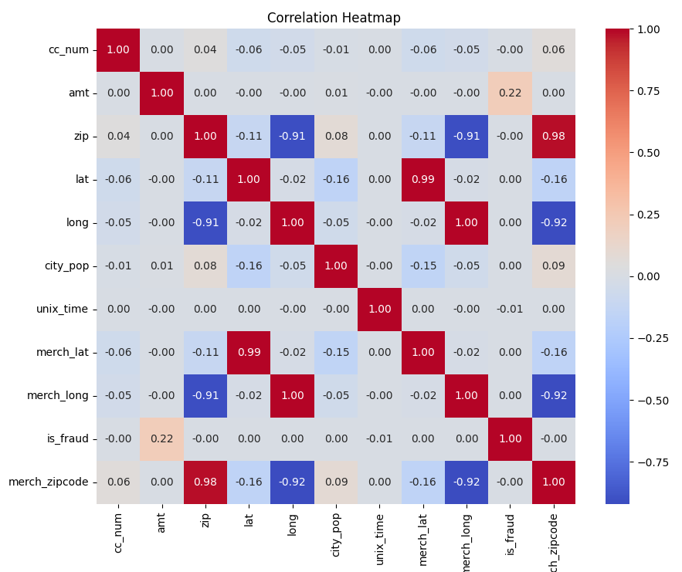
Correlation Heatmap

Slide 7
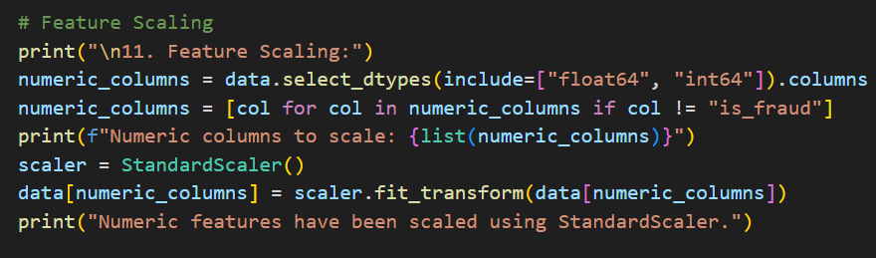
Feature Scaling
StandardScaler was used to standardize numerical features.
All numerical features except the target variable is_fraud.
Scaling ensures that features contribute equally to the model

Slide 8
Algorithm Selection
Options Considered:
Logistic Regression
Support Vector Machines (SVM)
Random Forest
Chosen Algorithm: Random Forest Classifier
Justification:
Handles high-dimensional data well.
Provides feature importance.
Robust to overfitting.

Slide 9
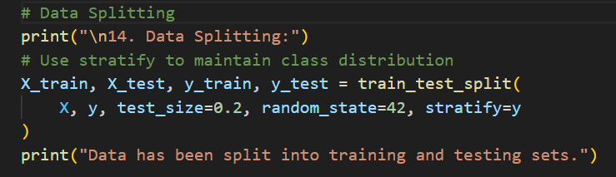
Data splitting
Method: Train-test split with 80% training data and 20% testing data.
Stratification: Used stratify=y to maintain class distribution between training and testing sets.

Slide 10
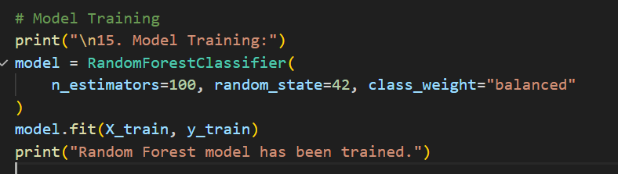
Model Training
Random Forest with default parameters and class_weight='balanced' to handle class imbalance.

Slide 11
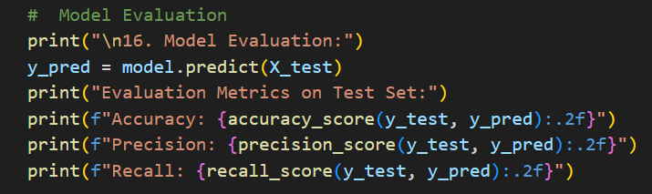
Model Evaluation
Results: The initial model showed great accuracy and precision but lower recall, indicating missed fraud transactions.
In fraud detection, recall is crucial to minimize false negatives.

Slide 12
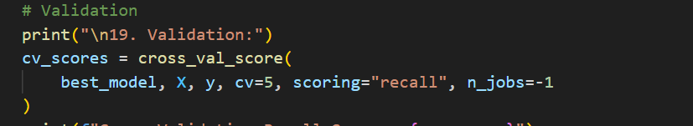
Validation
Cross-Validation: Performed 5-fold cross-validation using the best model.
Results: Improved mean recall score, indicating better generalization.

Slide 13
Conclusion
Successfully built a fraud detection model.
Provided valuable insights into key factors influencing fraudulent transactions.
The project demonstrates the effectiveness of machine learning in addressing critical financial security challenges.

Slide 14
Thanks!

